Slide 1
Chapter 3
Context-Free Grammars and Parsing
Ambiguous Grammar
Lijie Li
College of Computer Science & Technology
Harbin Engineering University
Compiler
1

Slide 2
Ambiguous Grammar
  exp → exp op exp | (exp) | number
  op → + | - | *
The string 34 – 3 * 42 has two different parse trees and syntax trees.
*
- 42
34 3
-
34 *
3 42
A grammar that generates a string with two distinct parse trees is called an ambiguous grammar.
Compiler

Slide 3
Two Ways to Deal with Ambiguity
Disambiguating rule
  State a rule that specifies in each ambiguous case which of the trees is correct.
  It corrects the ambiguity without changing and complicating the grammar.
  Syntactic structure of the language is not given by the grammar alone.
Change grammar into a form that forces the construction of a correct parse tree.
In both cases we must decide which of the trees are correct.
Compiler

Slide 4
Ambiguous Grammar
  exp → exp op exp | (exp) | number
  op → + | - | *
The string 34 – 3 * 42 has two different parse trees and syntax trees.
*
- 42
34 3
-
34 *
3 42
×
√
A grammar that generates a string with two distinct parse trees is called an ambiguous grammar.
Compiler

Slide 5
Precedence
Some operations have precedence over other operations.
  Multiplication has precedence over addition.
To handle the precedence of operations in the grammar, we group the operators into groups of equal precedence.
We must write a different rule for each precedence.
Compiler

Slide 6
Example
exp → exp op exp | (exp) | number
op → + | - | *
*
- 42
34 3
-
34 *
3 42
×
√
exp → exp addop exp | term
addop → + | -
term → term mulop term | factor
mulop → *
factor → (exp) | number
Compiler

Slide 7
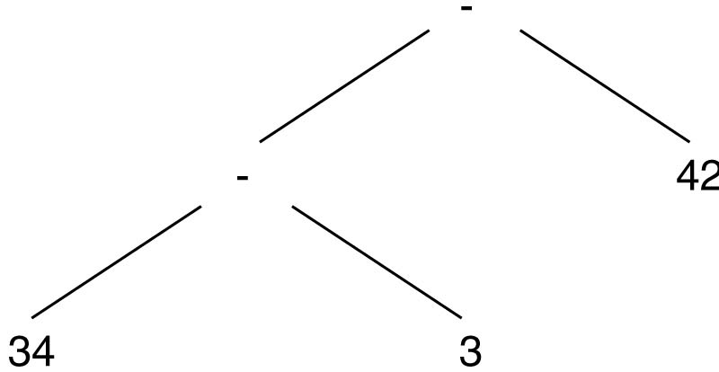
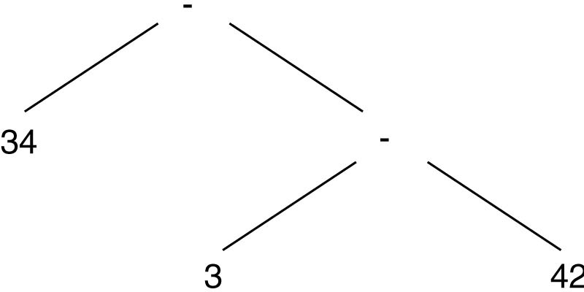
Ambiguous
exp → exp addop exp | term
addop → + | -
term → term mulop term | factor
mulop → *
factor → (exp) | number
34 – 3 – 42
√
×
(34 – 3) – 42 = –11
34 – (3 – 42) = 73
(34 – 3) – 42
Compiler

Slide 8
Associativity
Some operation (like subtraction) are left associative.
  A series of subtraction operations is performed from left to right.
exp → exp addop exp | term
  Recursion on both sides of the operator allows either side to match repetitions of the operator in a derivation.
exp → exp addop term | term
  The right recursion is replaced with the base case, forcing the repetitive matches on the left side
  Left recursion makes addition and subtraction left associative.
Compiler

Slide 9
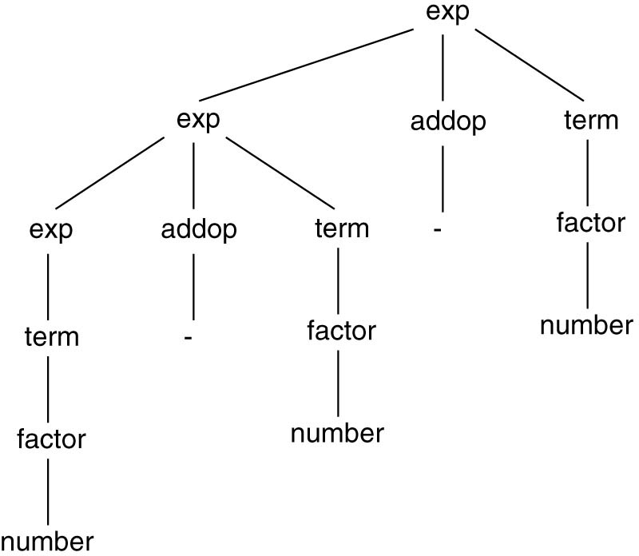
Example
34 - 3 - 42 has a unique parse tree
Compiler

Slide 10
Example
exp → exp addop term | term
addop → + | -
term → term mulop factor | factor
mulop → *
factor → (exp) | number
34- 3* 42 has a unique parse tree
exp
exp addop term
term - term mulop factor
factor factor * number
number number
Compiler

Slide 11
Dangling else Problem
statement → if-stmt | other
if-stmt → if (exp) statement
| if (exp) statement else statement
exp → 0 | 1
if (0) if (1) other else other has two parse trees with two meaning
if (0) if (1) other else other and
if (0) if (1) other else other
√
×
Compiler

Slide 12
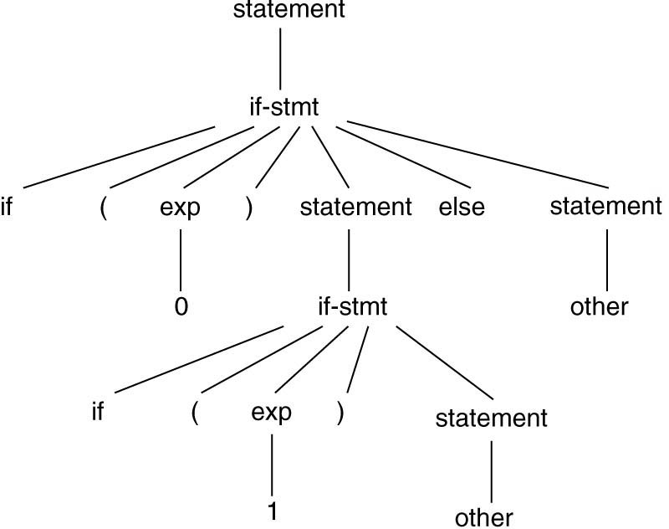
if (0) if (1) other else other
Compiler

Slide 13
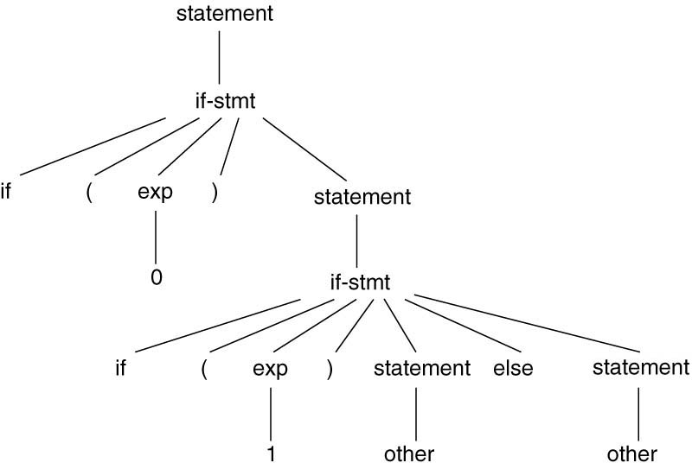
if (0) if (1) other else other
Compiler

Slide 14
Dangling else Problem
statement → if-stmt | other
if-stmt → if (exp) statement
| if (exp) statement else statement
exp → 0 | 1
if (0) if (1) other else other has two parse trees with two meaning
if (0) if (1) other else other and
if (0) if (1) other else other
Modify the grammar.
Compiler

Slide 15
Dangling else Problem
statement → matched-stmt | unmatched-stmt
matched-stmt → if (exp) matched-stmt else
matched-stmt | other
unmatched-stmt → if (exp) statement
| if (exp) matched-stmt else unmatched-stmt
exp → 0 | 1
Compiler

Slide 16
Dangling else Problem
statement → if-stmt | other
if-stmt → if (exp) statement
| if (exp) statement else statement
exp → 0 | 1
if (0) if (1) other else other has two parse trees with two meaning
if (0) if (1) other else other and
if (0) if (1) other else other
Modify the grammar.
Disambiguating rule: the most closely nested rule.
Compiler

Slide 17
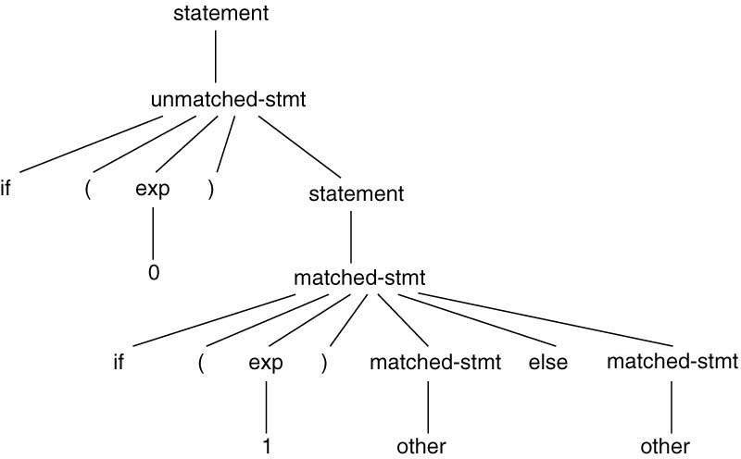
Dangling else Problem
if (0) if (1) other else other
statement → matched-stmt | unmatched-stmt
matched-stmt → if (exp) matched-stmt else
matched-stmt | other
unmatched-stmt → if (exp) statement
| if (exp) matched-stmt else unmatched-stmt
exp → 0 | 1
Compiler

Slide 18
Inessential Ambiguity
Sometimes a grammar may be ambiguous and yet always produce unique abstract syntax trees.
Example:
( a + b ) + c = a + ( b + c )
Compiler

